Slide 1

ODATA SERVICES
Presented By :
Rohit Koppa

Slide 2

Agenda
What is ODATA and Why
Create/implement ODATA
Expose Data

Slide 3
WHAT IS ODATA ?
OData is an Open Data Protocol used in web technologies.
OData is first introduced by Microsoft now it is being used for web applications, mobile applications etc.
The current recommended version of OData is 4.0
OData is used by SAP to make SAP data accessible to other platforms so that the non SAP users can also access this data to develop web applications, websites, mobile apps, etc.
OData fetches the data from one or many database and tables with the help of select, insert, delete or modify statements.

Slide 4
What is the need for OData service ?
OData service is used in the SAP gateway to connect with non-SAP platforms.
There are three types of OData services.
OData ABAP services
OData HANA services
OData External services

Slide 5
WHAT ARE THE USES OF ODATA SERVICE?
It is based on the HTTP framework.
In other words in the application layer, we have an internal table and that internal table data is passed out through OData to HTTP.
In a single HTTP request, you can get both the data and metadata or table structure and you can also do CRUD-Q operations
The job of ODATA services is to fetch data from the database and table to OData services through SQL Statements,
And from ODATA services the data is displayed on the front end application screen like SAP UI5 or FIORI screen in the form of some screen elements like Tables, Graphs, Dropdowns, Radio buttons Checkboxes etc.
The front end services like SAP UI5 or FIORI screen will be the same for all ODATA services whether it is ODATA services for ABAP or HANA or External services.

Slide 6
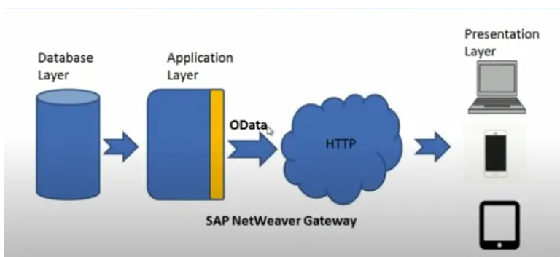
SAP NetWeaver Gateway
SAP NetWeaver 7.5 SP 26
SAP Netweaver Gateway is a technology that offers connectivity to SAP applications using any programming language or model without the need for SAP knowledge by using REST services and OData protocols.
In other words, SAP Netweaver is a technology which helps devices, environments or platforms to access SAP using OData services.
It converts the internal table into OData format.
In other words, SAP Gateway is like a medium for the outside world to connect with SAP and transfer data to or from SAP.

Slide 7
Creating OData
To implement ODATA sap has developed Netweaver gateway
To expose business data via ODATA then we need this gateway component installed in our system
SAP also provides tool called Netweaver Gateway Builder using this we can add our RFC’s or BAPI’s as an ODATA service
Transaction code is: SEGW
We will be defining data model and registering this with Netweaver gateway under the service maintenance(/o/iwfnd/maint_service)
I have created ODATA service using cds views and SEGW.

Slide 8
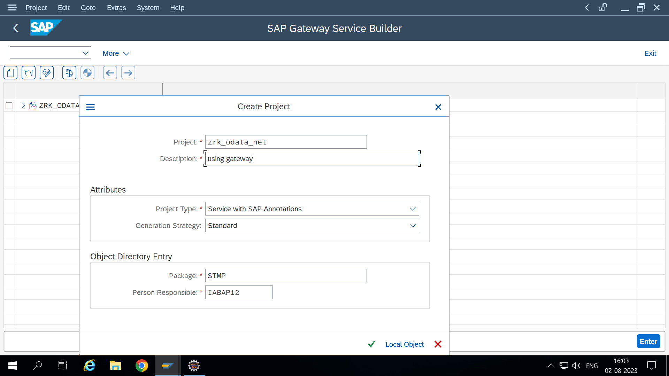
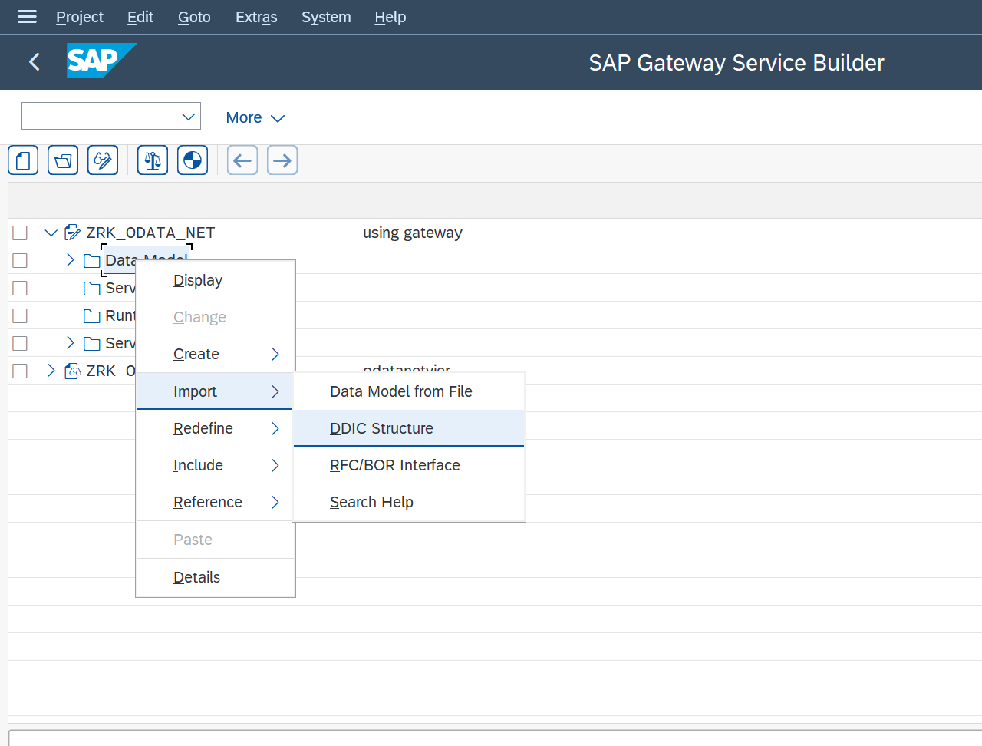
Implementation Using SEGW:

Slide 9
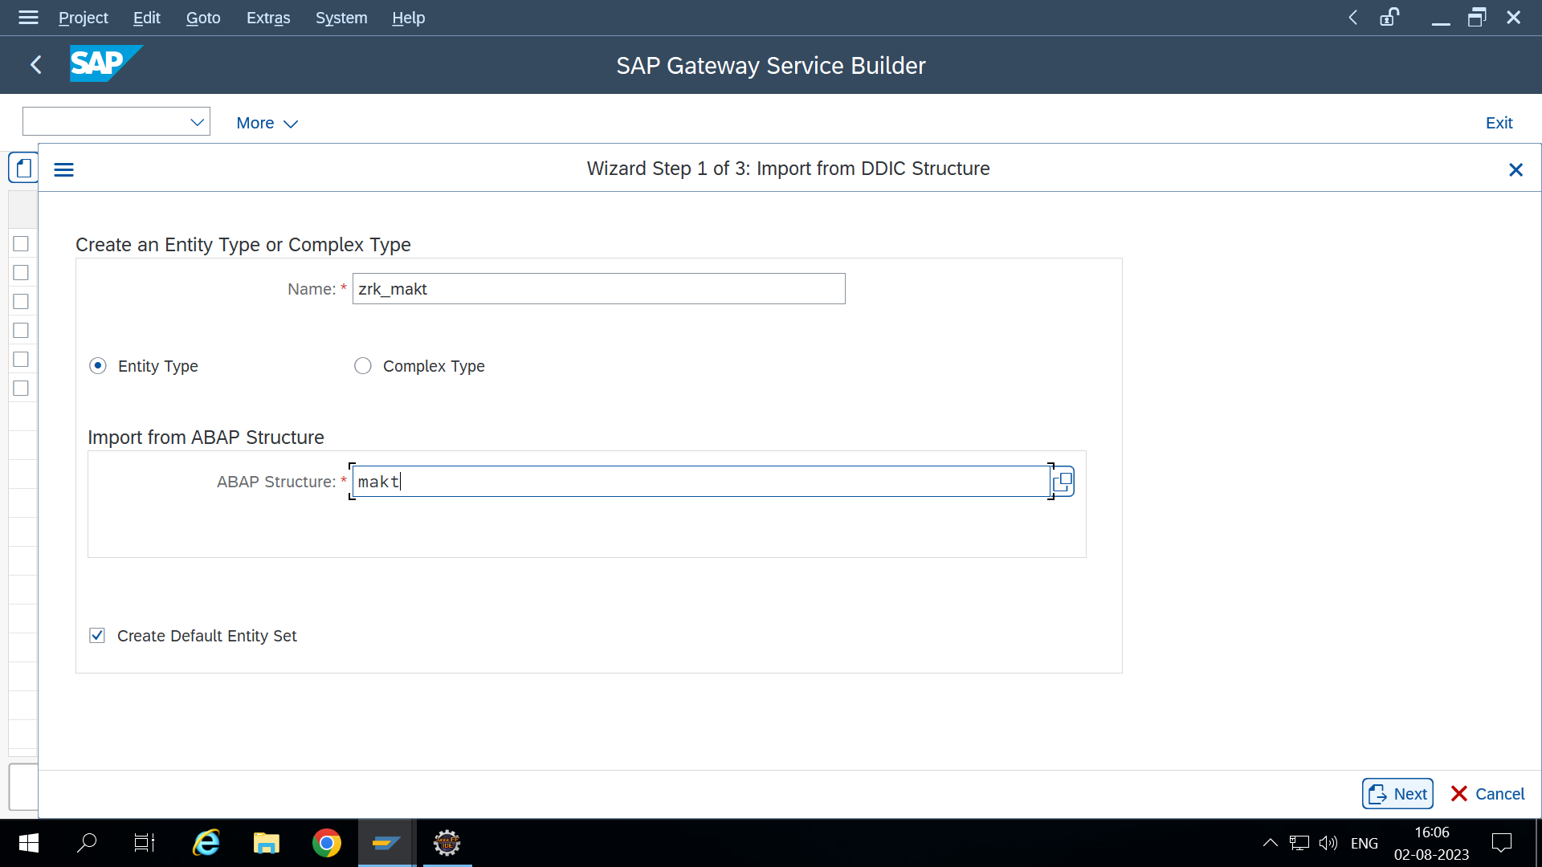
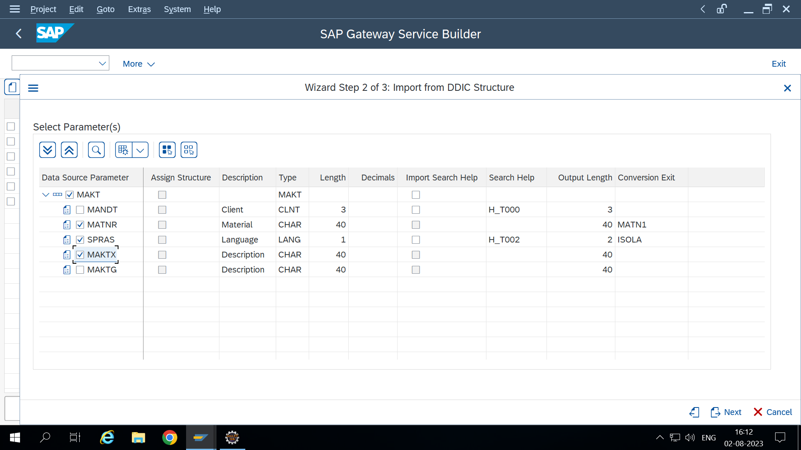

Slide 10
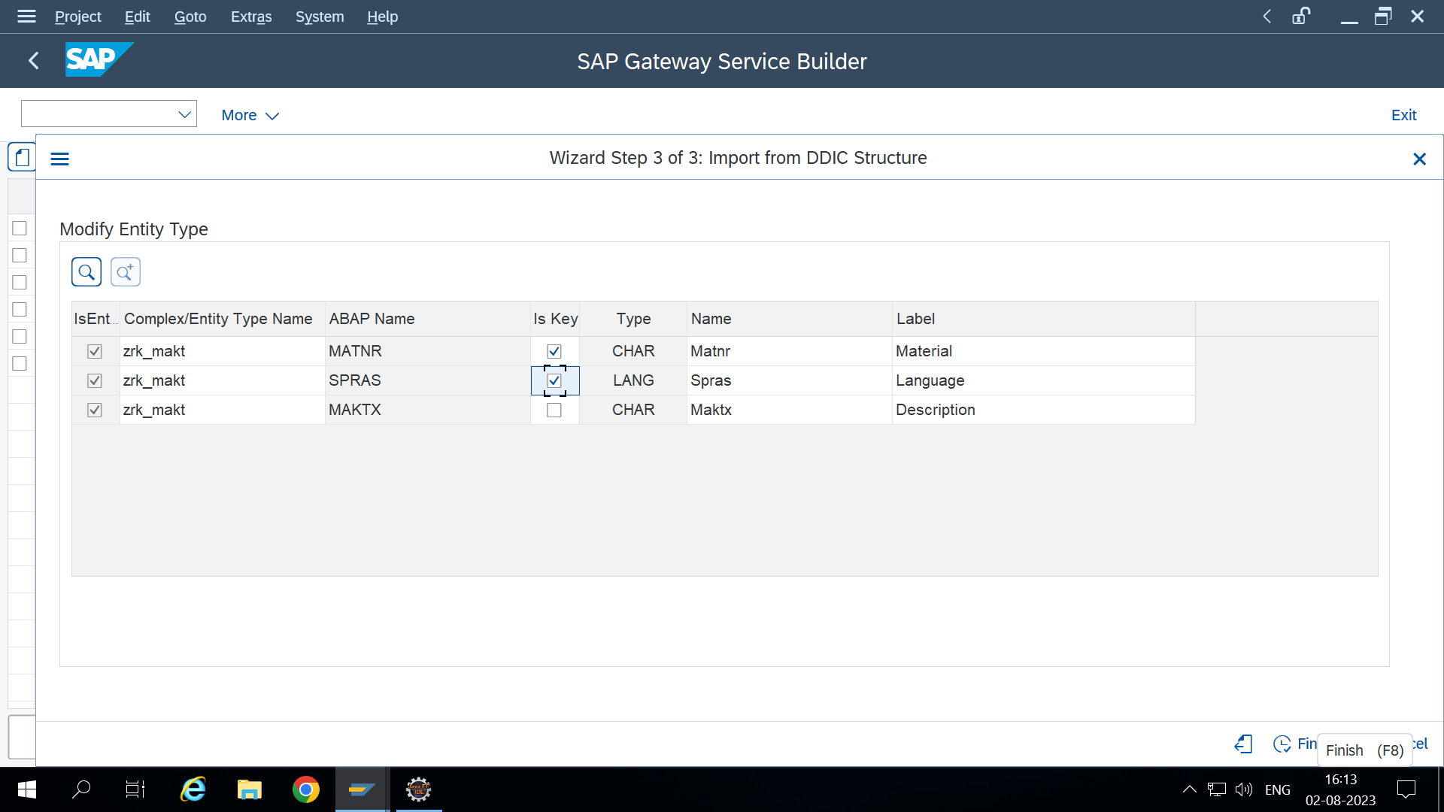
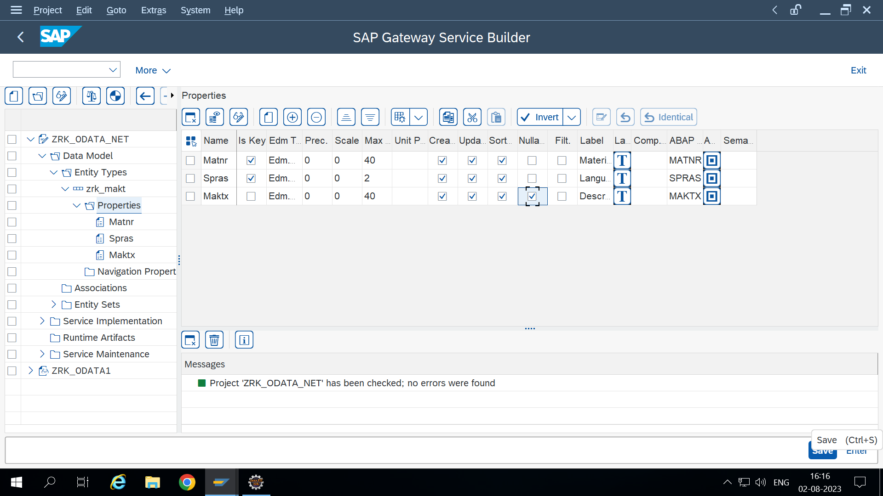

Slide 11
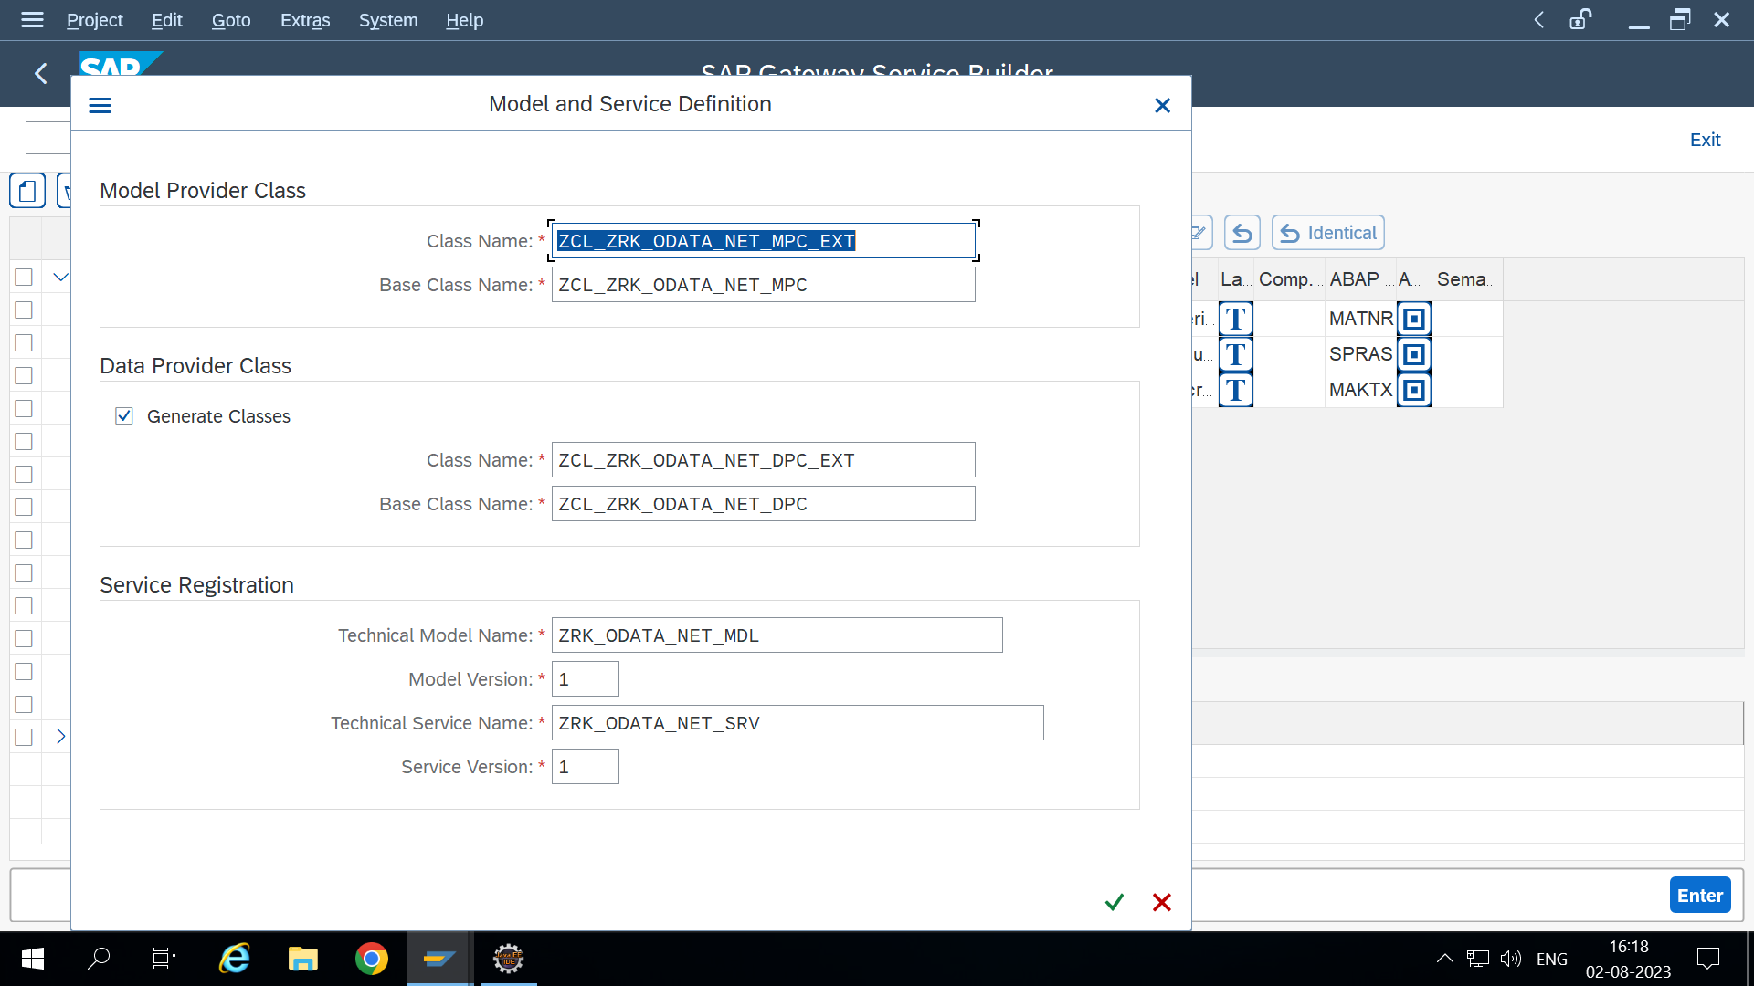
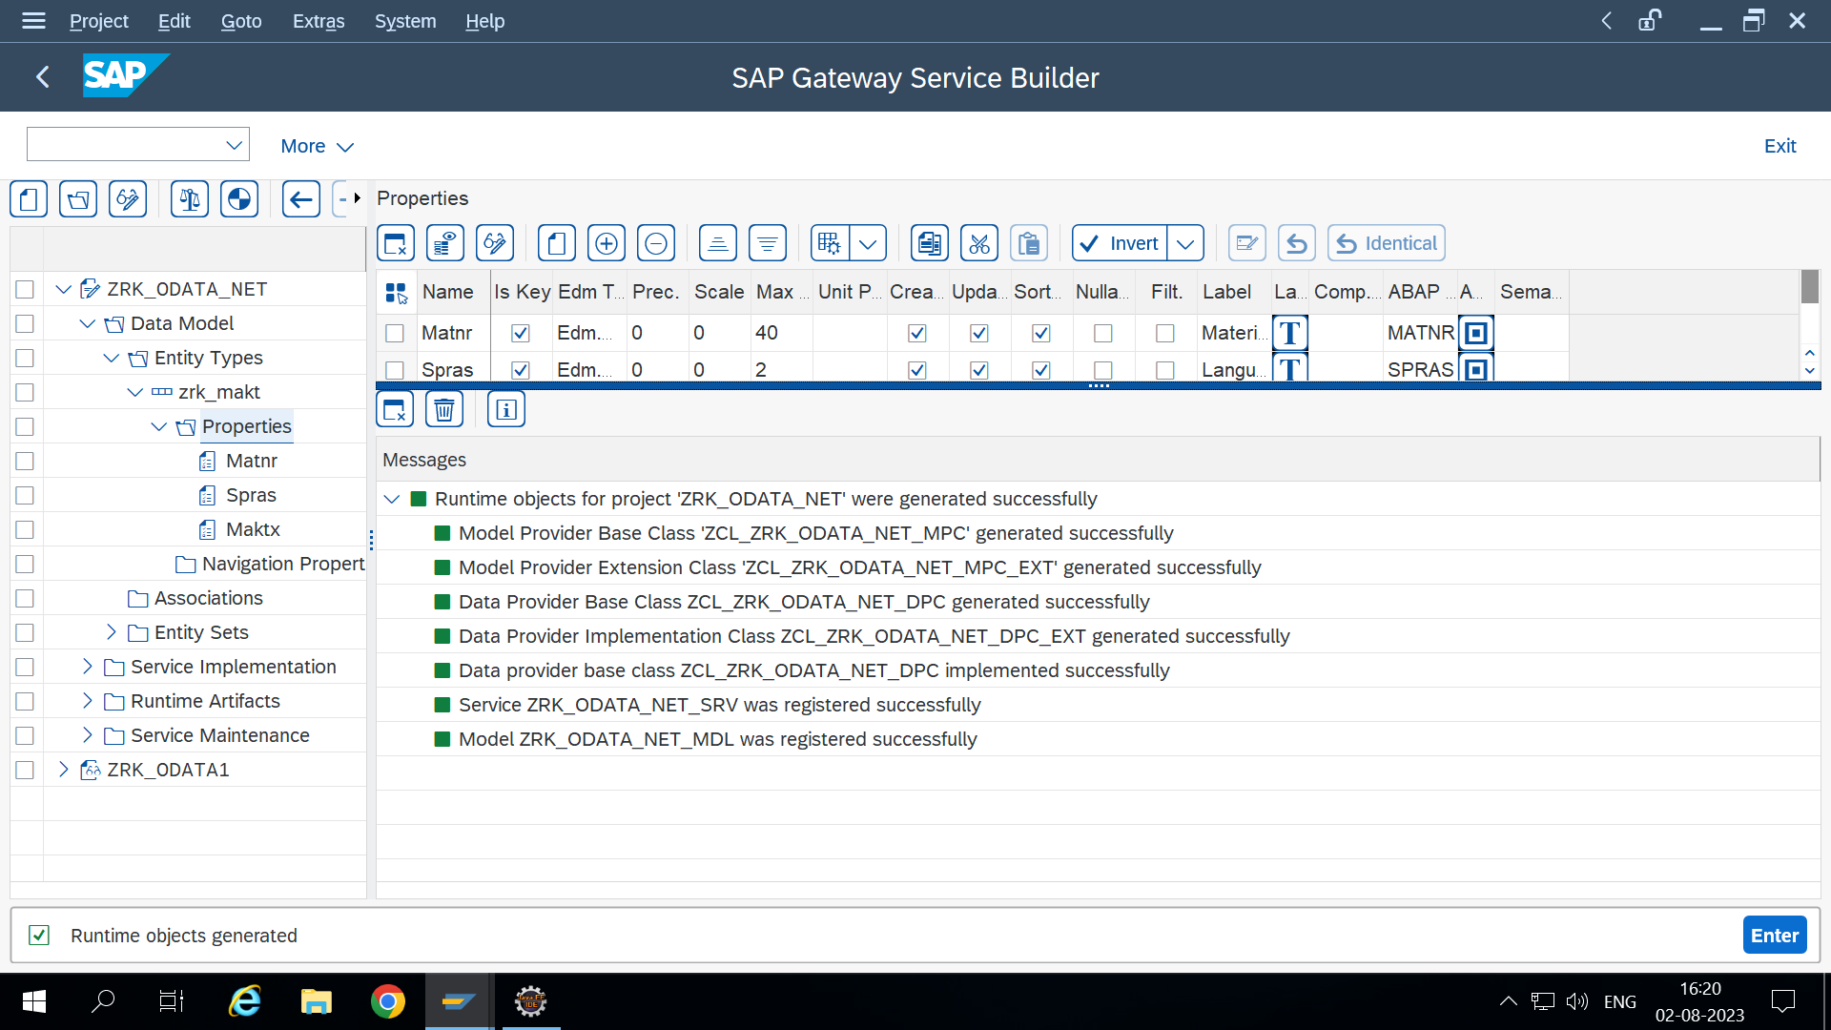

Slide 12
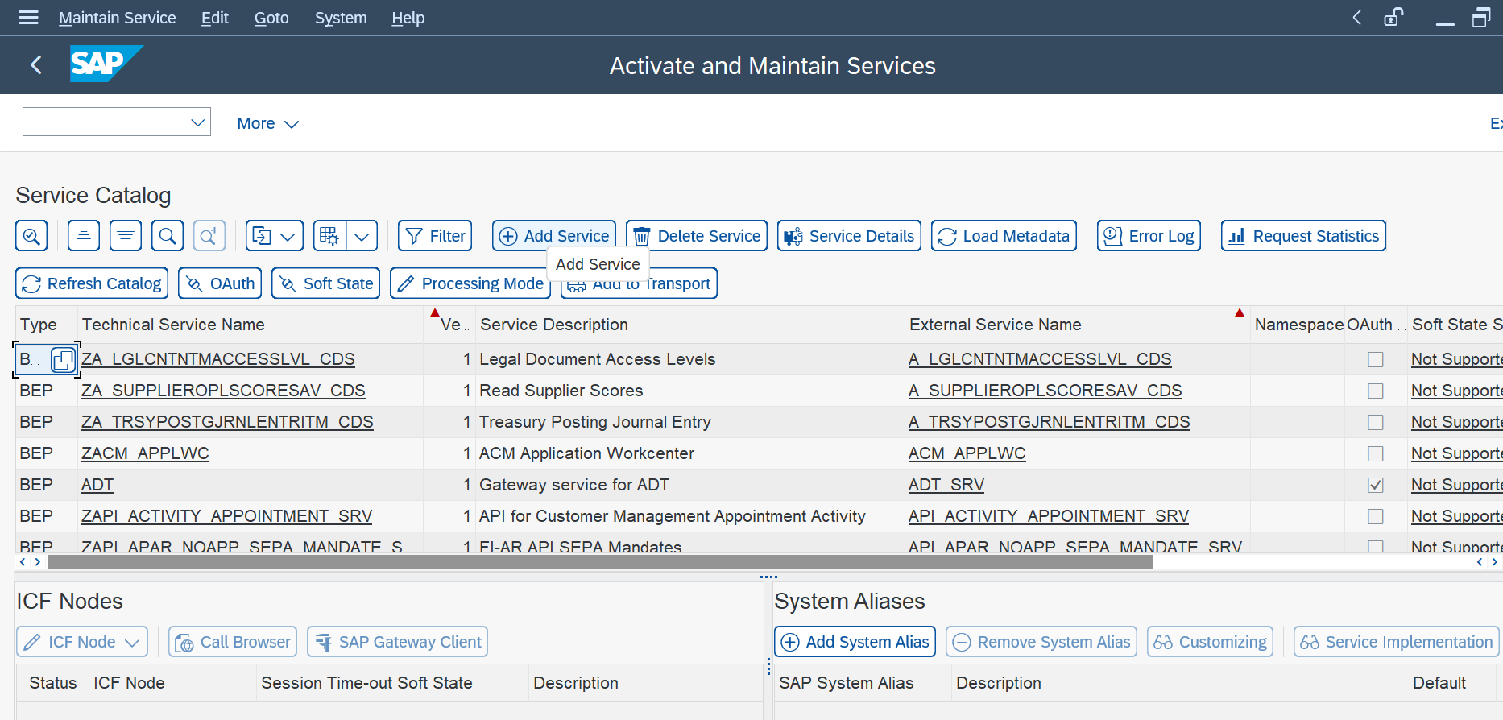
Will go to activate and maintain Services:

Slide 13
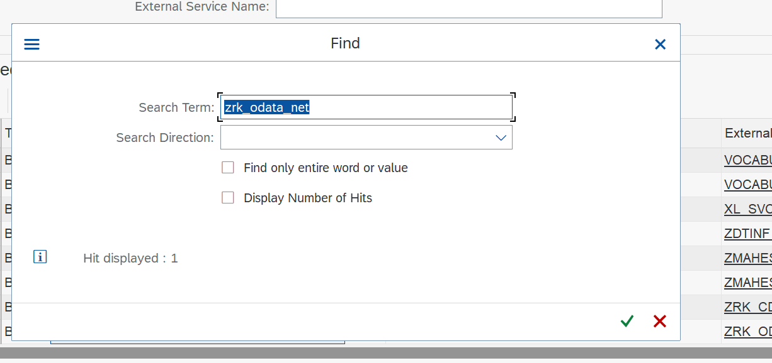
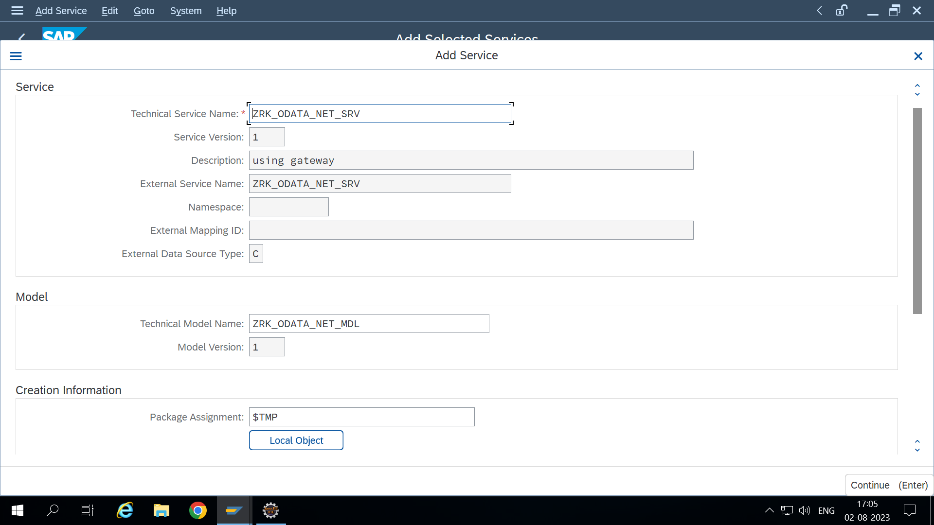

Slide 14
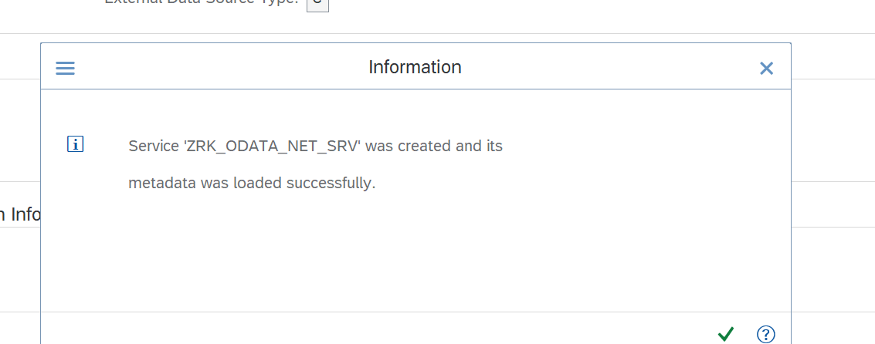
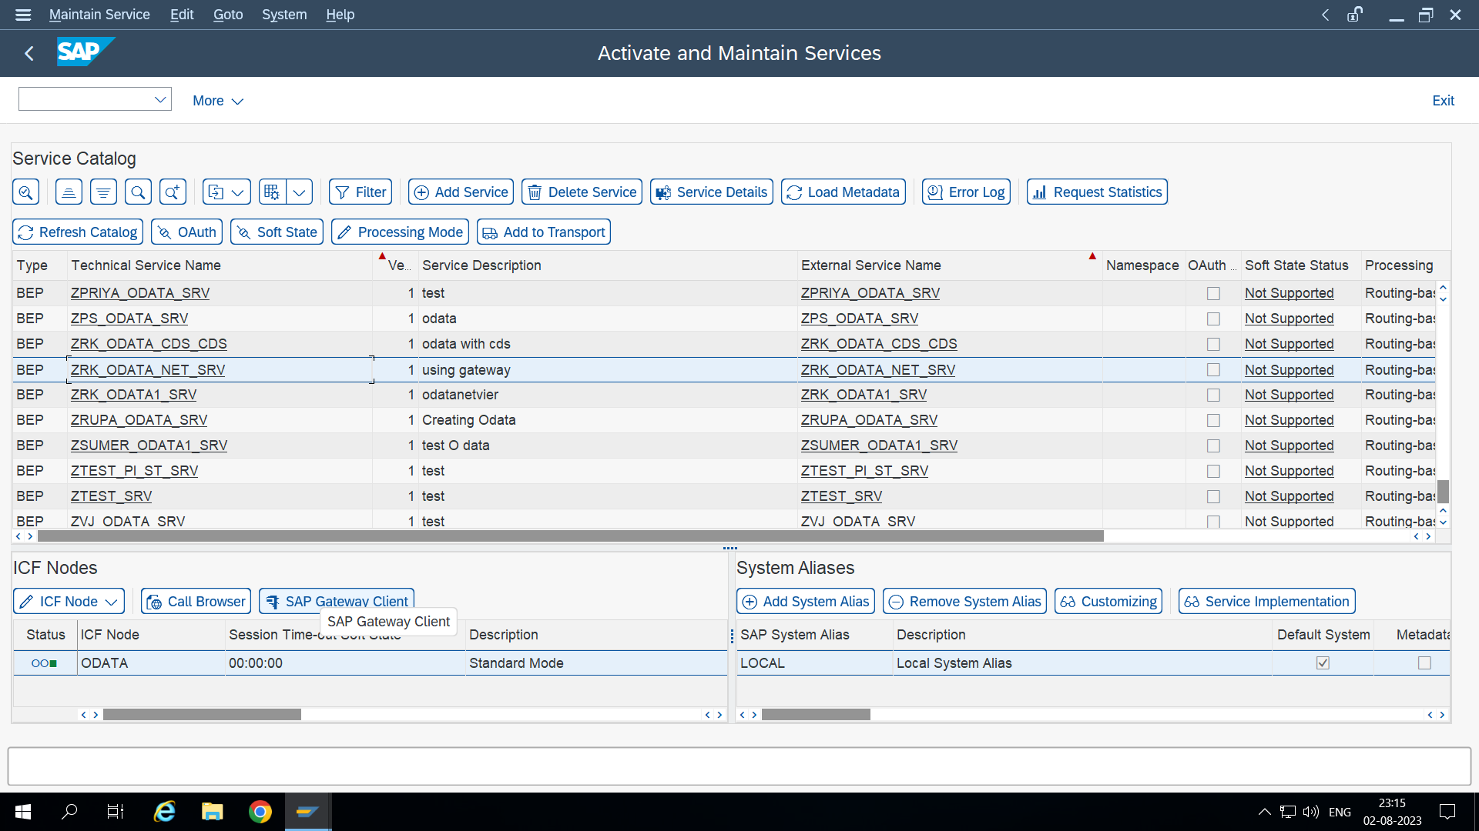

Slide 15
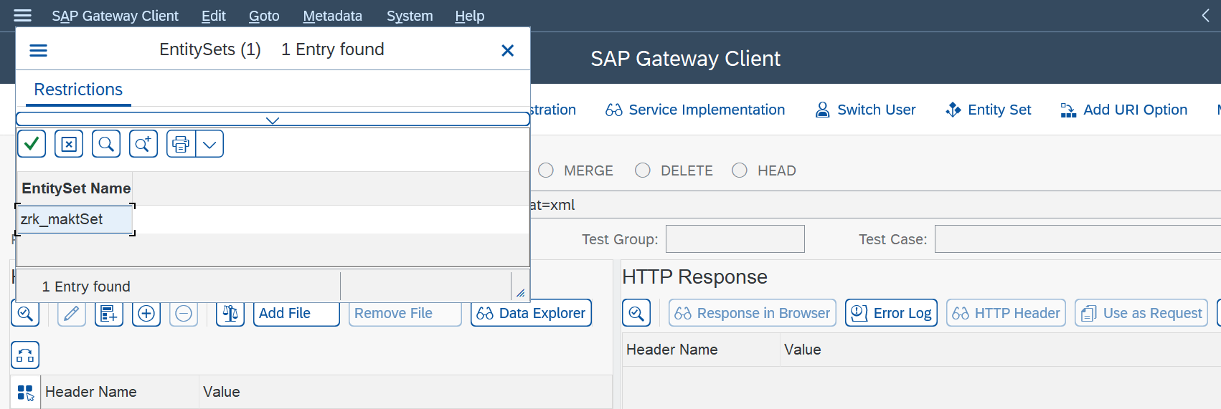
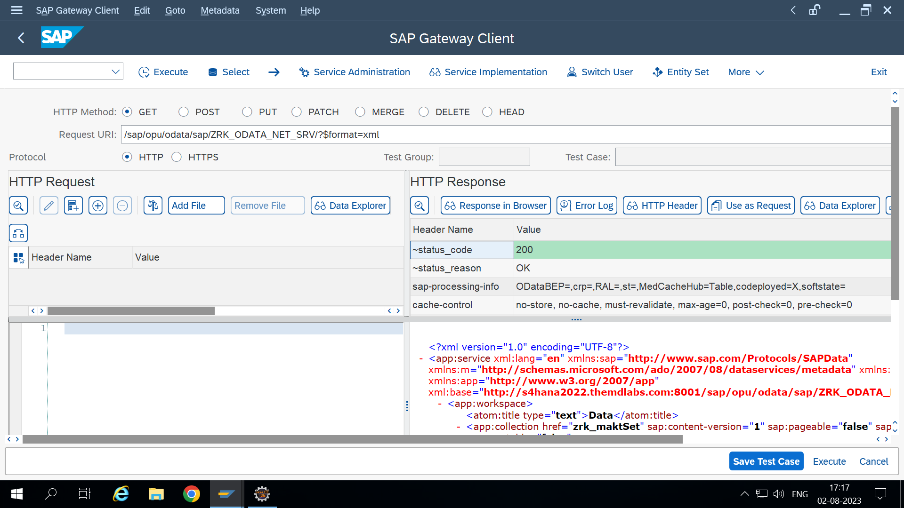

Slide 16
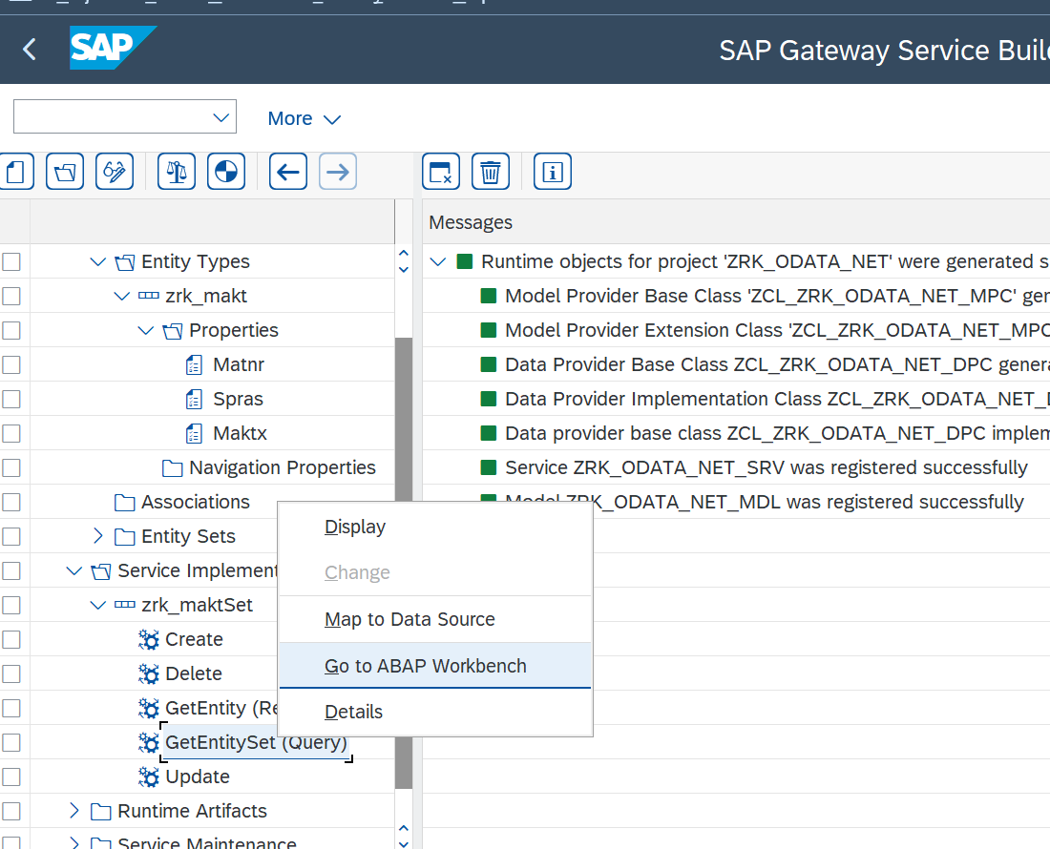
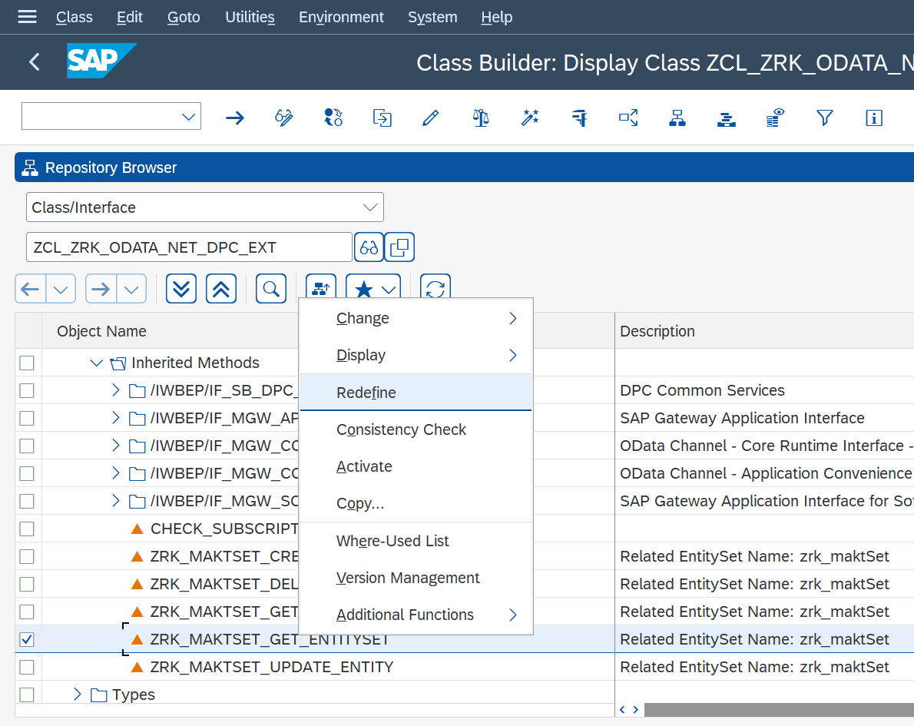
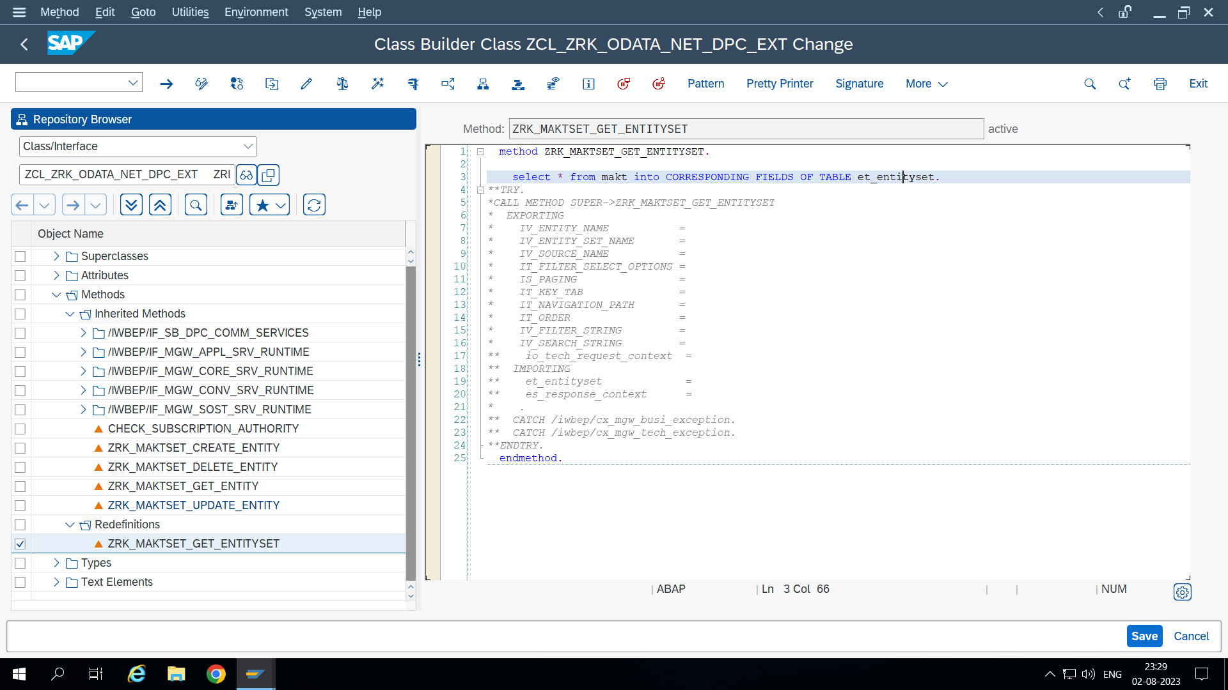
Expose Data:

Slide 17
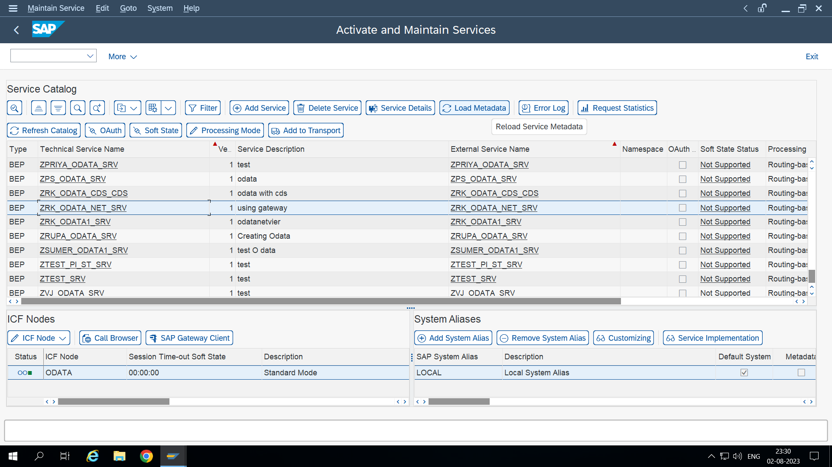
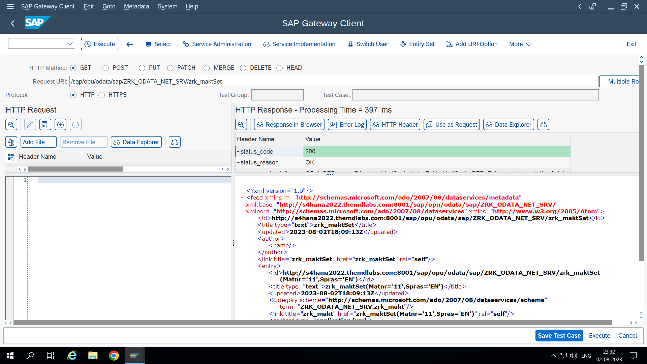

Slide 18
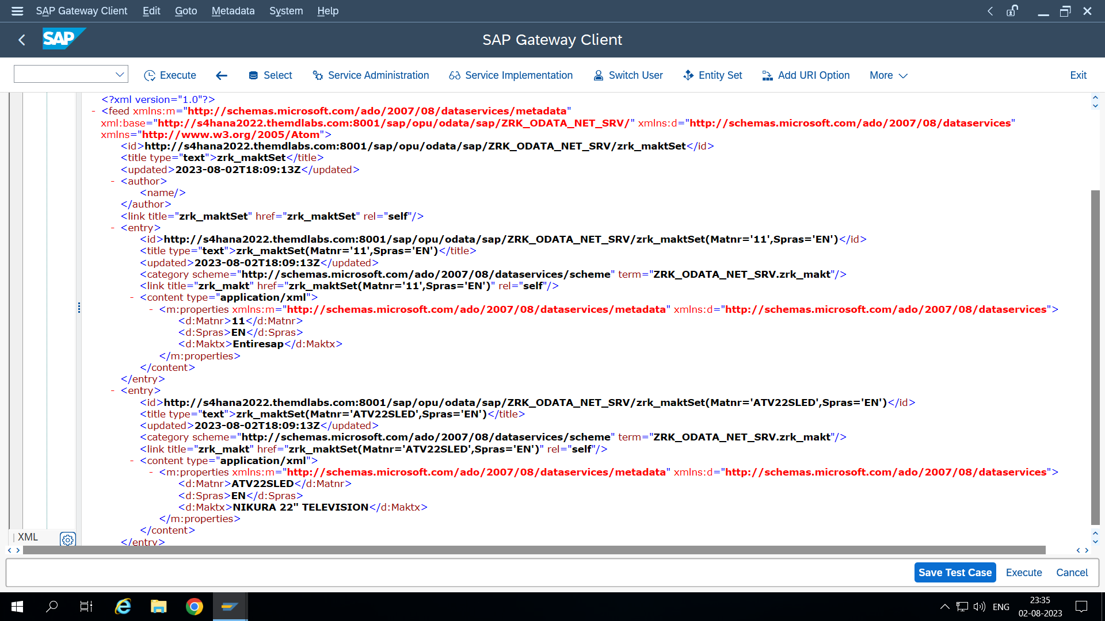
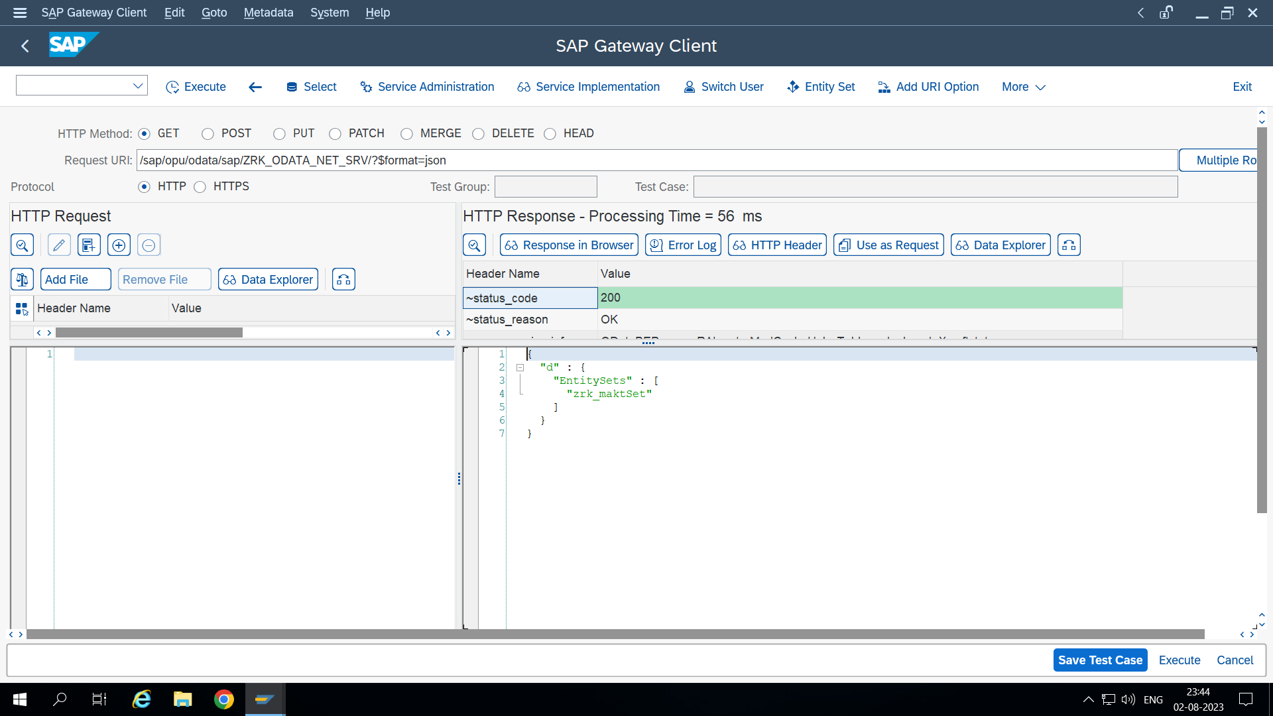

Slide 19
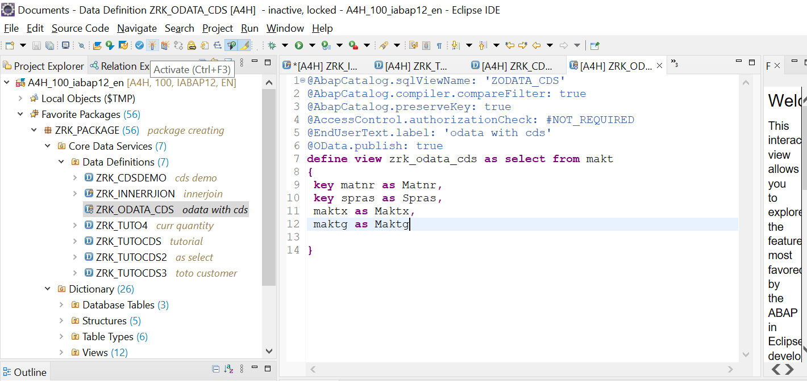
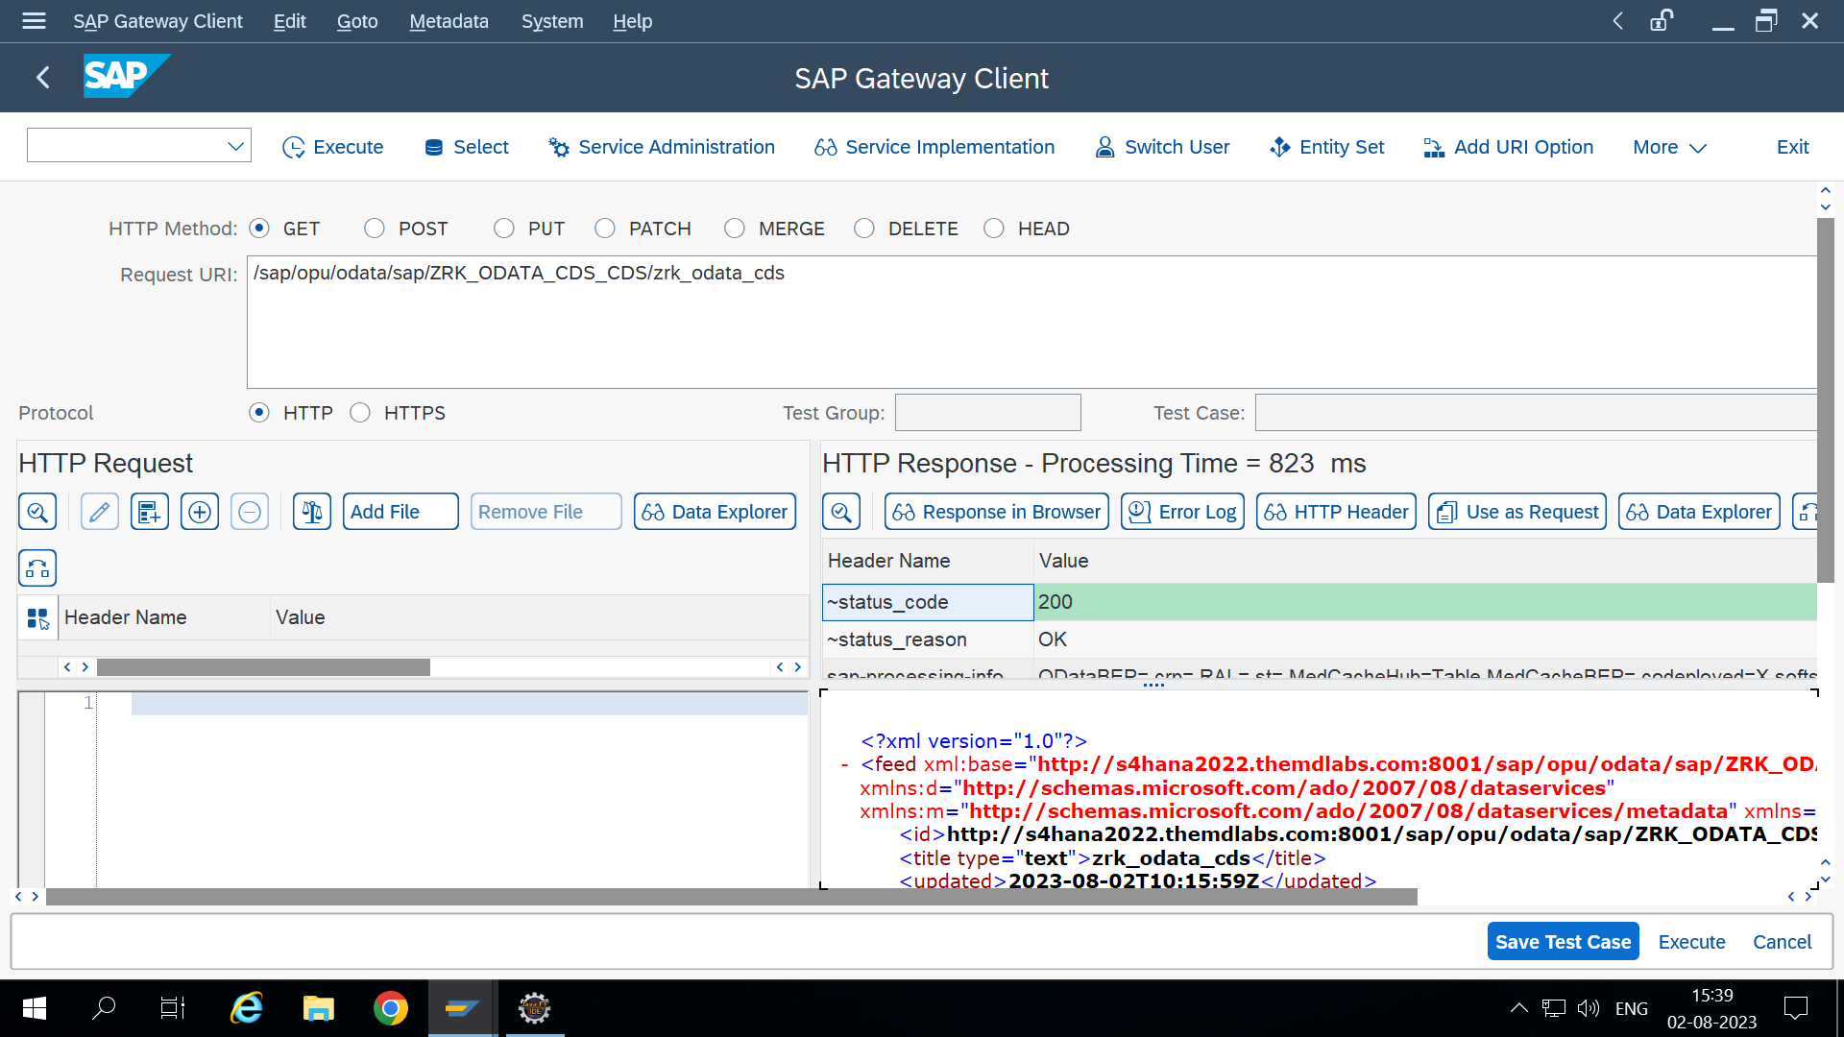
Using CDS view: create OData service & register service in maintain service

Slide 20
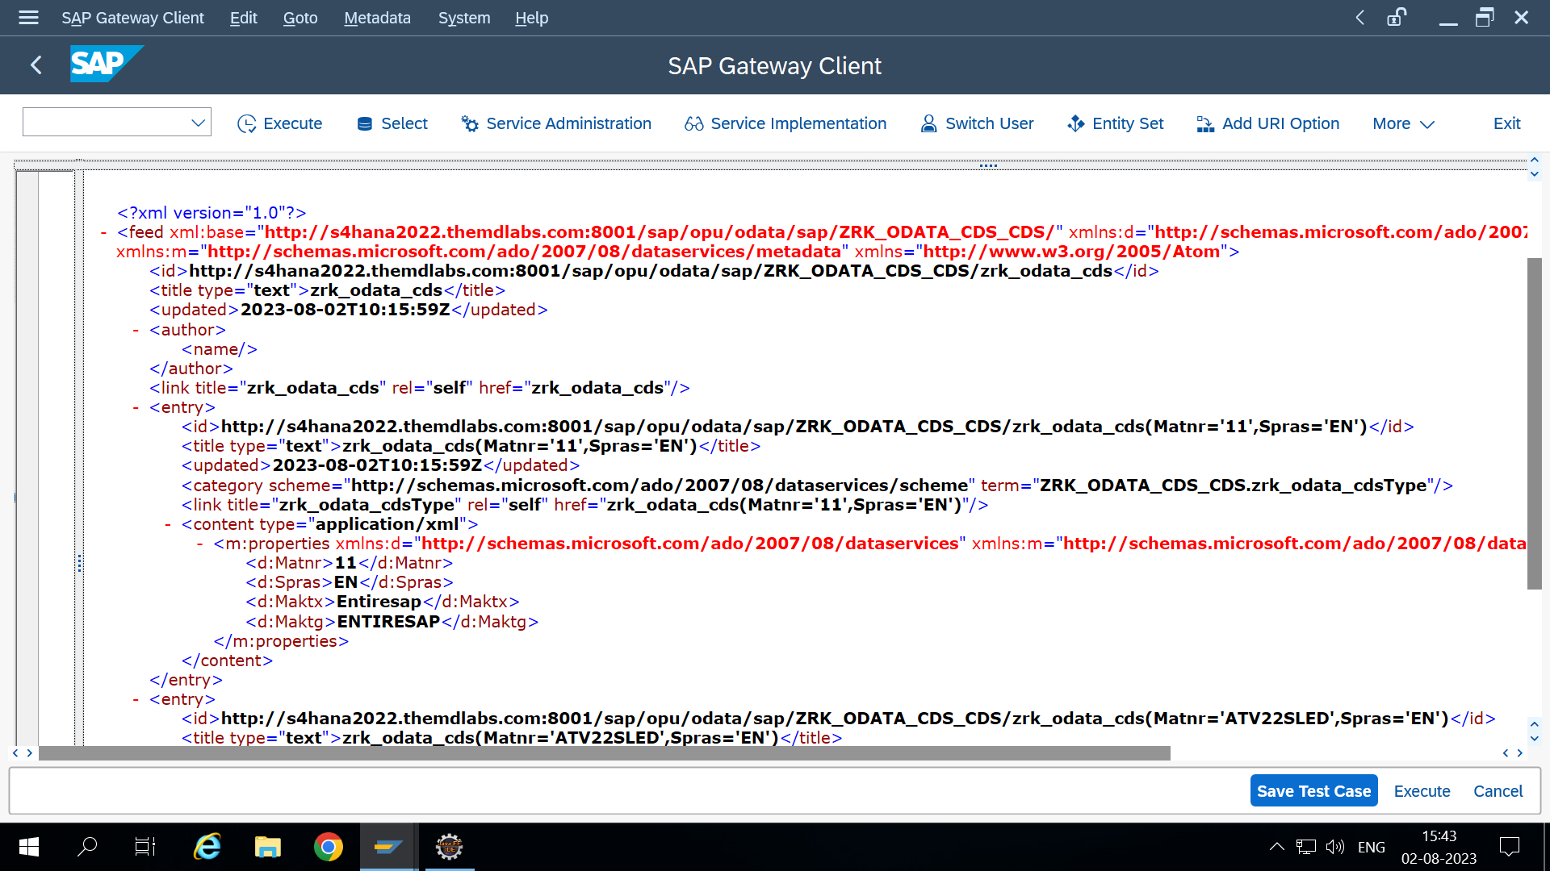

Slide 21
Thank you

